Slide 1
DATA BASE MANAGEMENT APPLICATION FOR LIBRARY AND STUDENT INFORMATION
BY
AKASH B
ABHIJITH K
ANKITA KR
AMRUTHA A

Slide 2
PROBLEM STATEMENT
To build a database management application to access data of students and library information based on the given dataset.

Slide 3
ROLE OF TEAM MEMBERS
Abhijit- Back-end sql implementation
Akash- UI and web designing
Amrutha and Ankita- sql codes and data works

Slide 4
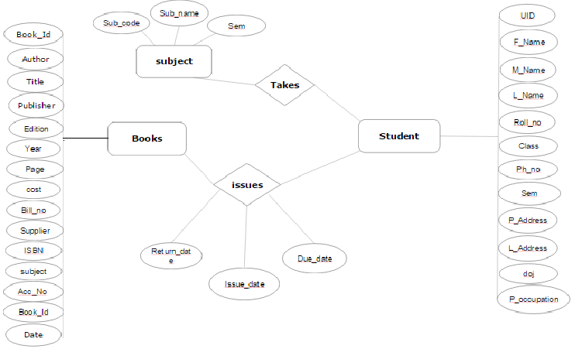
ER MODEL

Slide 5
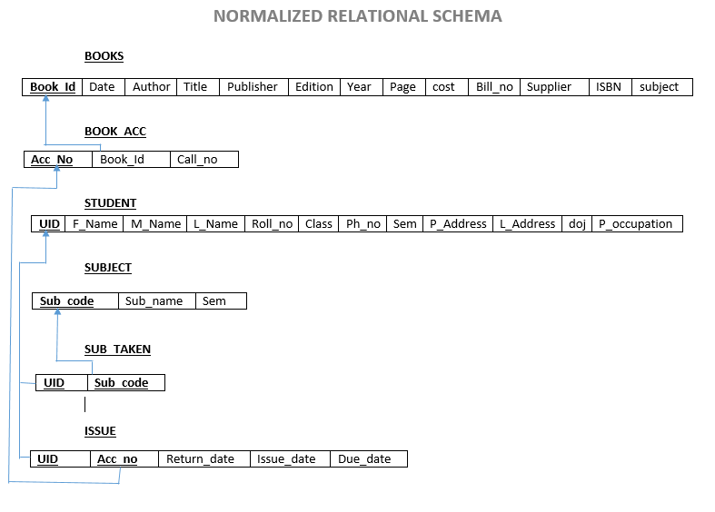
NORMALIZED RELATIONAL SCHEMA

Slide 6
Changes specified:
Added home button link.
Easy access to database link.
Auto assignment of unique ids(Yet to be completed)
Functionalities:
Security (Administrative access)
Multi-user access
App is uploaded online and made available on Internet,
Hence, any time access is possible.

Slide 7
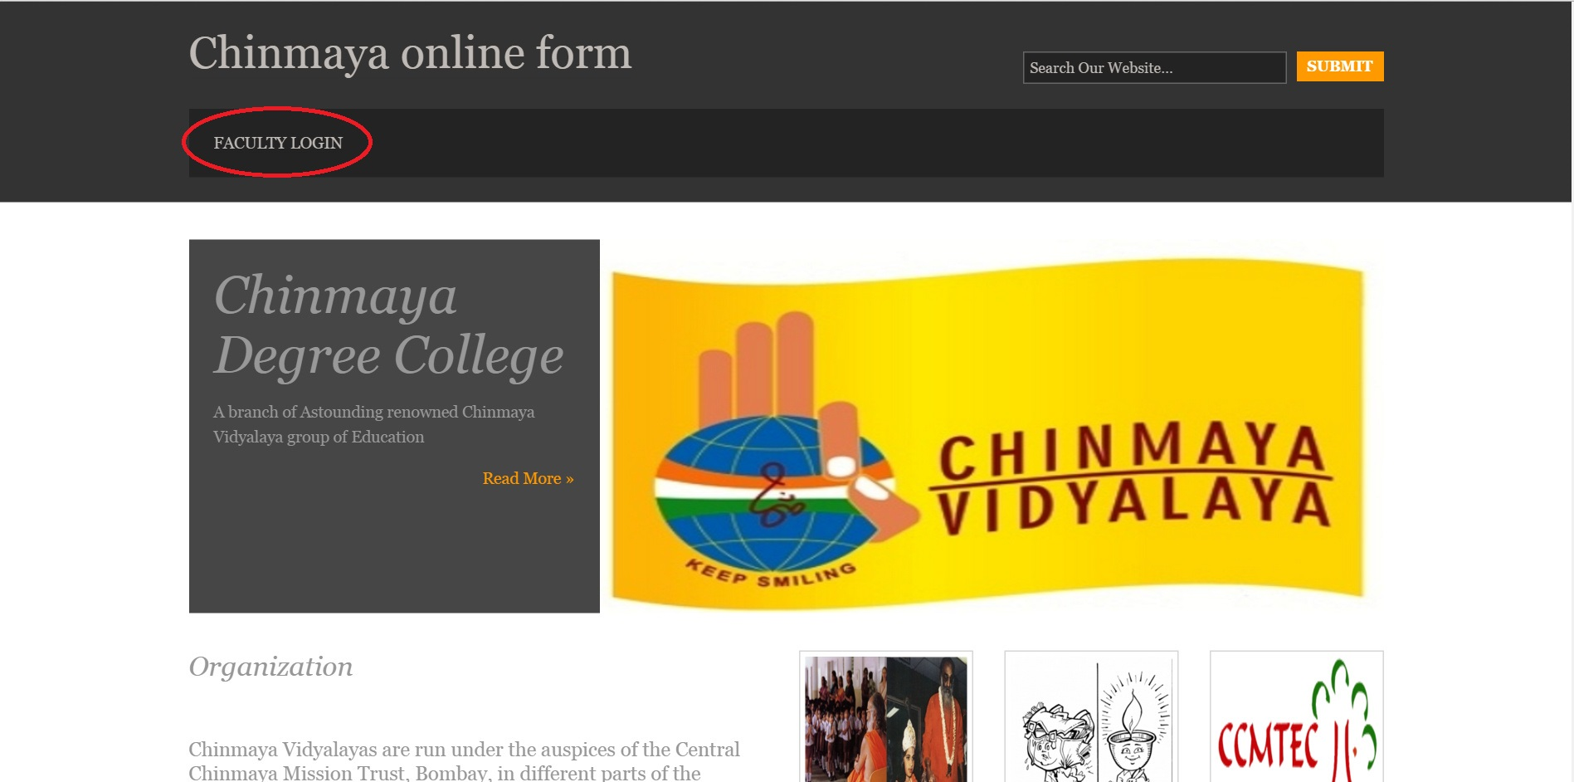
UI DESIGN

Slide 8
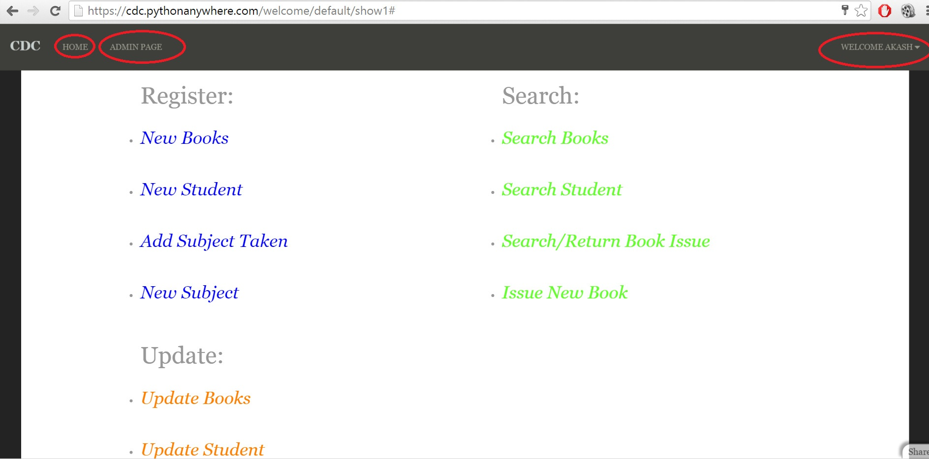

Slide 9
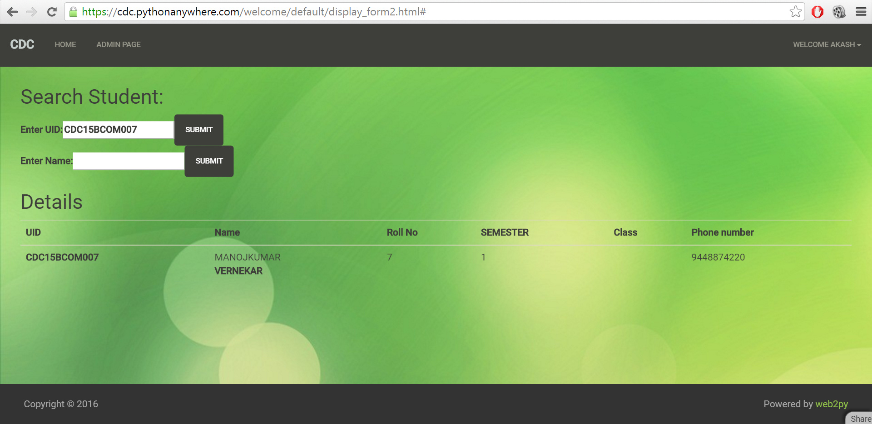

Slide 10


